Slide 1
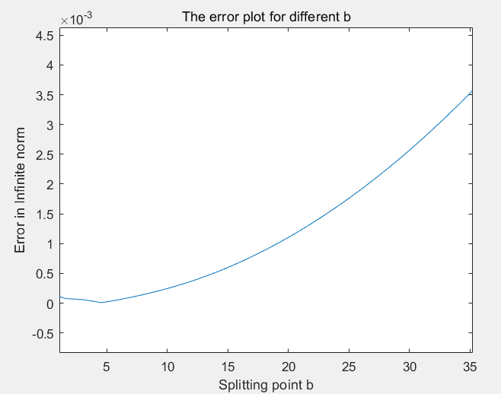
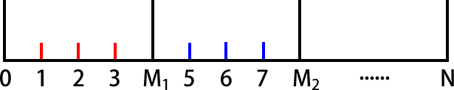
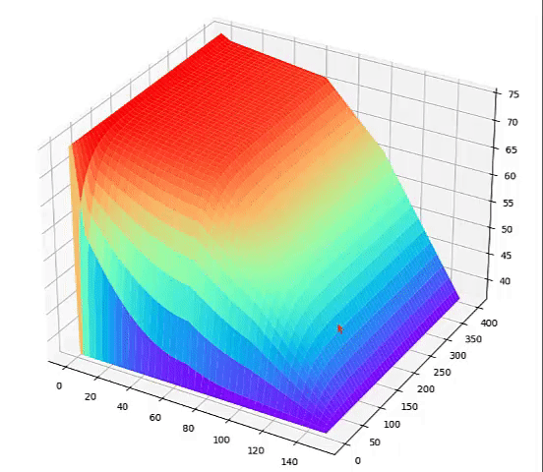
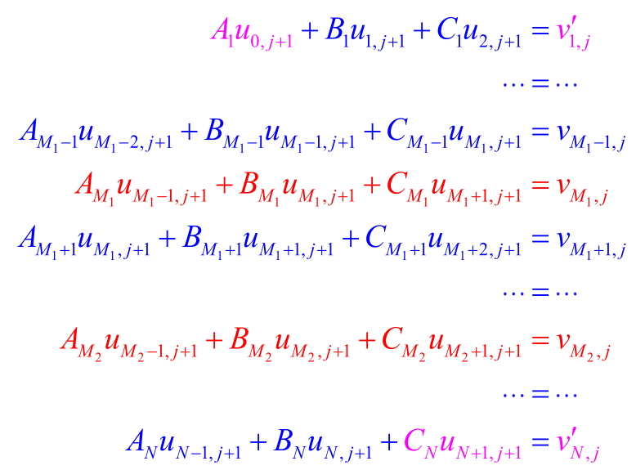
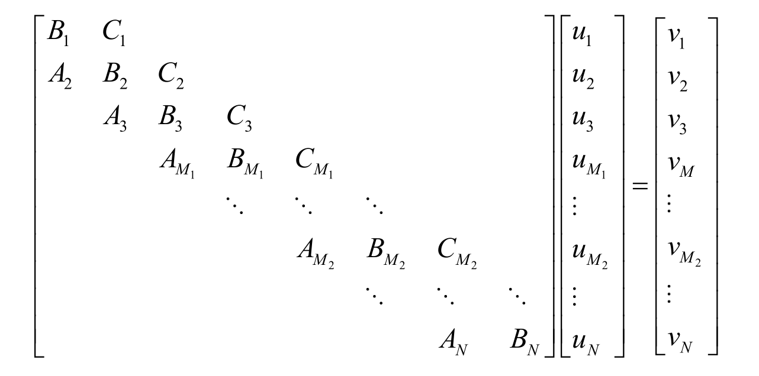
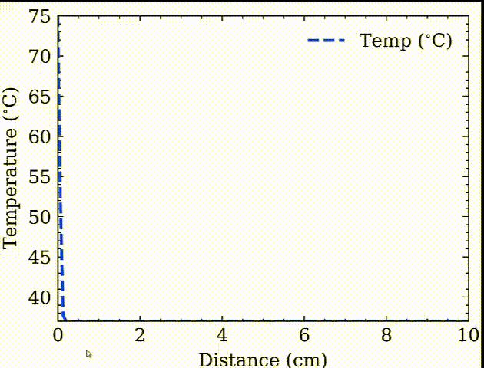
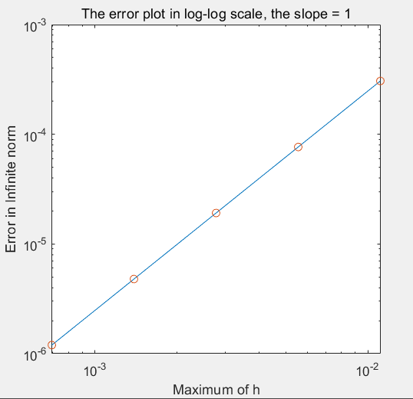
Numerical Solutions & Analysis for PDEs&ODEs
Zihang Zhang (ZJU), Lizhang Chen(BJTU)
Faculty Advisor: Dr. Zhilin Li (NCSU)
Abstract
Methods
Results
❑Infinite domain problems can be applied broadly and effectively in our daily life such as temperature distribution in physical phenomena and option pricing in financial mathematics.
❑Sturm–Liouville theory is the theory of real second-order linear ordinary differential equations of a certain form. Sturm–Liouville
equations have been widely researched and its numerical solutions can have good properties.
❑ Partial Differential Equations (PDEs) can be applied broadly and effectively in our daily life such as temperature distribution in physical phenomena and option pricing in financial mathematics.
❑The heat equation is a parabolic PDE that describes the distribution of heat (or variation in temperature) in a given region over time.
❑Finite difference method
,where
Applying Taylor expansion, we can see the pattern is second order convergent.
❑Splitting method
Split the interval into two intervals:
and , and in the second interval,
Let , then the original equation
transforms to
,which is a transformation of a Sturm-Liouville equation having boundary
❑ Finite-Diﬀerence Approximations to the Heat Conduction Equation
❑ Error analysis
Three parts of different truncation error
Interval :
Interval :
Point b :
Compare all the three errors,
we prove in theory the error
converges by second order.
Switch b to see when
the error is the smallest.
Fix n1=100, n2=50, a=1,
Switch b between 0 and 100,
We see at point b=4.49 the
error reaches its bottom.
❑The numerical solution of heat equation
Objectives & Applications
Figure 2. Error plot for different b
❑Validate some finite difference methods to solve one dimensional Stum-Liouville problems and use them to solve one dimensiional finite domain problems.
❑Transform a classical infinite domain ordinary differencial equations into a Sturm-Liouville problem, generate a method for numerical solutions, analyze and minimize the error.
❑ Develop and validate some finite difference methods to solve parabolic PDEs such as the heat equation numerically. And we build a model to solve the special clothing design for high temperature work.
Figure 3. Temperature changes with time goes
Models
❑ Infinite domain problem in 1D
❑ Boundary conditons
❑ Sturm-Liouville problem
❑ Boundary conditons
❑ Heat Equation in 1D
❑ Boundary conditions
❑ Initial Condition:
Results
❑Infinite domain problem
Splitting method
Solve the equation for
Boundaries :
Choose b=10
Switch n1,n2
Plot infinite norm of error
Against the maximum of h.
The plot proves the error
converges by second order.
Figure 4. Temperature distribution with respect to time and space
Future Work
❑ Carry out furthur and deeper error analysis and work out a general code to generate the numerical solution for the infinite domain problem which minimize the overall error.
❑ Extend the splitting method further into infinite domain partial differential equations and utilize polar coordinates to generate a solution.
❑ Combine our mathematical learning with financial problems like put option with infinite domain.
Figure 1. Error plot in log-log scale
Contact
References
[Name] Zihang Zhang
[Organization] School of Mathematics, Zhejiang University
[Address] 2 Huaifang North Road, Fengtai District, Beijing
[Email] zzhleon@163.com
[Phone] 086-17787248696
[Name] Lizhang Chen
[Organization] School of Science, Beijing Jiaotong University
[Address] No.3 Shangyuancun, Haidian District,Beijing 100044 P. R. China
[Email] lz.chen0807@gmail.com
[Phone] 086-18310588966
Li, Z., Qiao, Z., & Tang, T. (2018). Numerical solution of differential equations: Introduction to finite
difference and finite element methods. Cambridge, UK: Cambridge University Press.

